Slide 1


BLO App (Erstwhile Garuda App)

Slide 2

Purpose
This presentation will facilitate BLO in understanding use of BLO App in fulfilling his responsibilities.
Field verification of forms submitted through online/offline mode
Filling of required forms on behalf of elector
Performing house to house survey (H2H)
Gathering Polling station related information :
Presence of Assured (AMF) and Extended Minimum Facilities (EMF)
Capturing of GPS co-ordinates of polling station
Capturing photos of polling station

Slide 3

Contents
Download and Login into BLO APP
Tour to Home Page
Submission of forms
Tracking of forms
Checklist Submission
House to House survey
Updating Facilities in Polling station
1
2
3
4
5
6
7

Slide 4
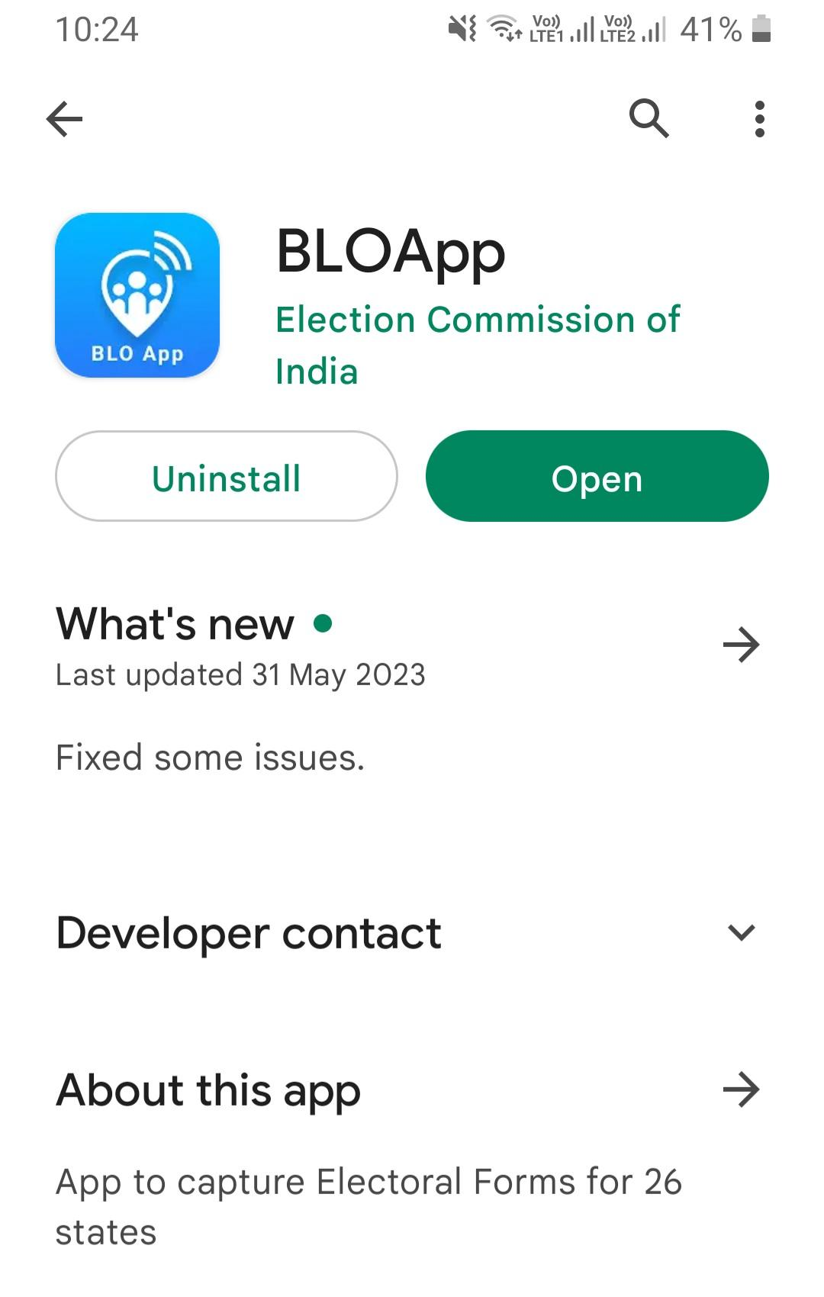

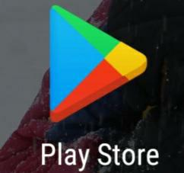
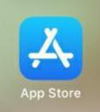
Downloading the BLO App
BLO App can be downloaded and installed using Play Store ( in Android Phones ) or App Store ( in i-phones)

Slide 5


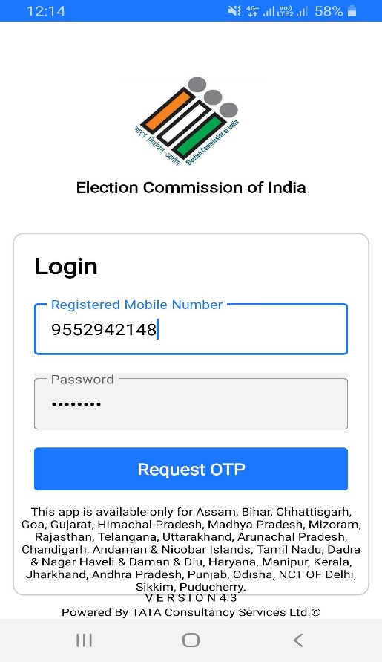
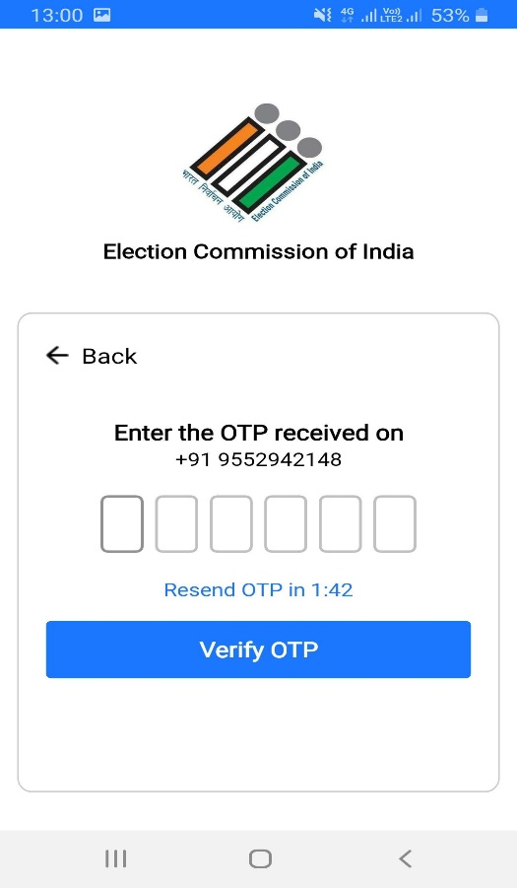

Login into BLO App
BLO will request OTP by entering registered mobile number
Post OTP verification user will be able to login successfully

Slide 6



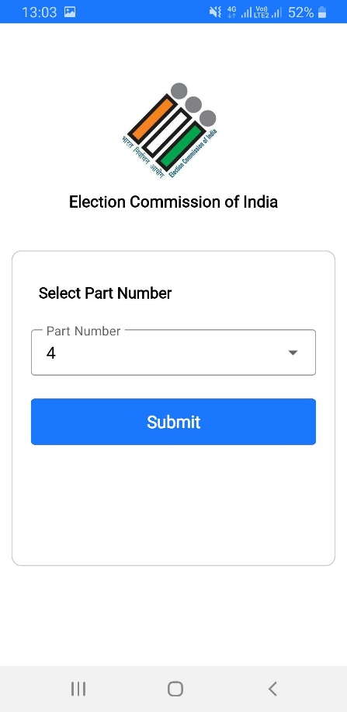
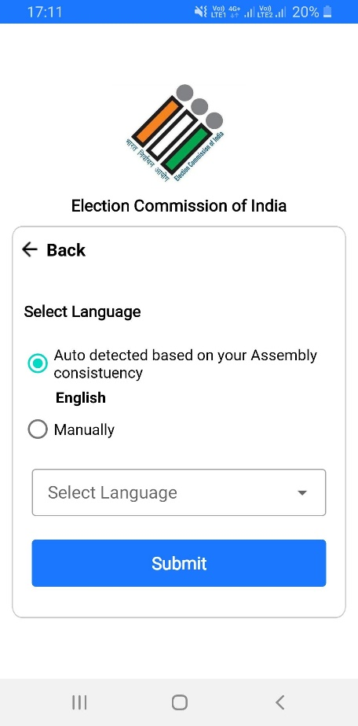
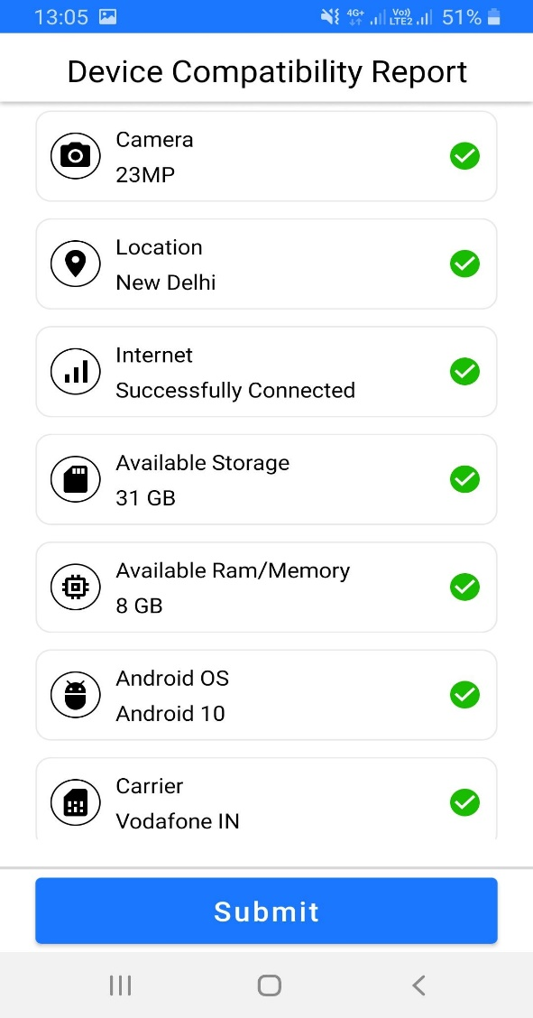
Login into BLO App
BLO must select the assigned part from drop down. If BLO is assigned multiple parts, however BLO can login for one part at a time
By default, first vernacular language will be auto selected based on part. And if there are more than one vernacular language of AC then that will be shown in ‘Manual’ dropdown
BLO can view whether mobile is fulfilling minimum requirements for smooth running of the App. By clicking on submit BLO will be directed to HOMEPAGE

Slide 7
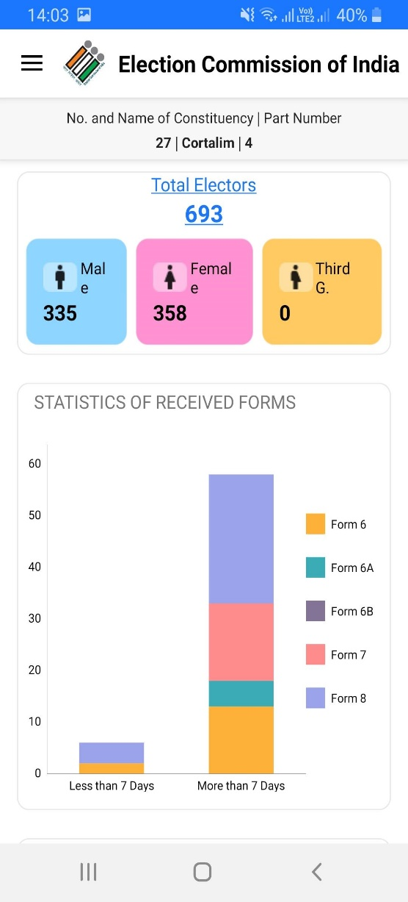

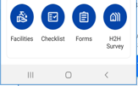
Tour to Home Page
BLO will see details of selected part and AC
BLO will see count of total electors in part and their gender segregation as well. By clicking on ‘Total Electors’, BLO can see details of electors in part
BLO will see count of pending forms for field verification. BLO can also monitor how many forms are pending from less than 7 days and greater than 7 days
On scrolling down, BLO will see options for ‘Facilities’, ’Checklist’, ’Forms’ and H2H survey

Slide 8

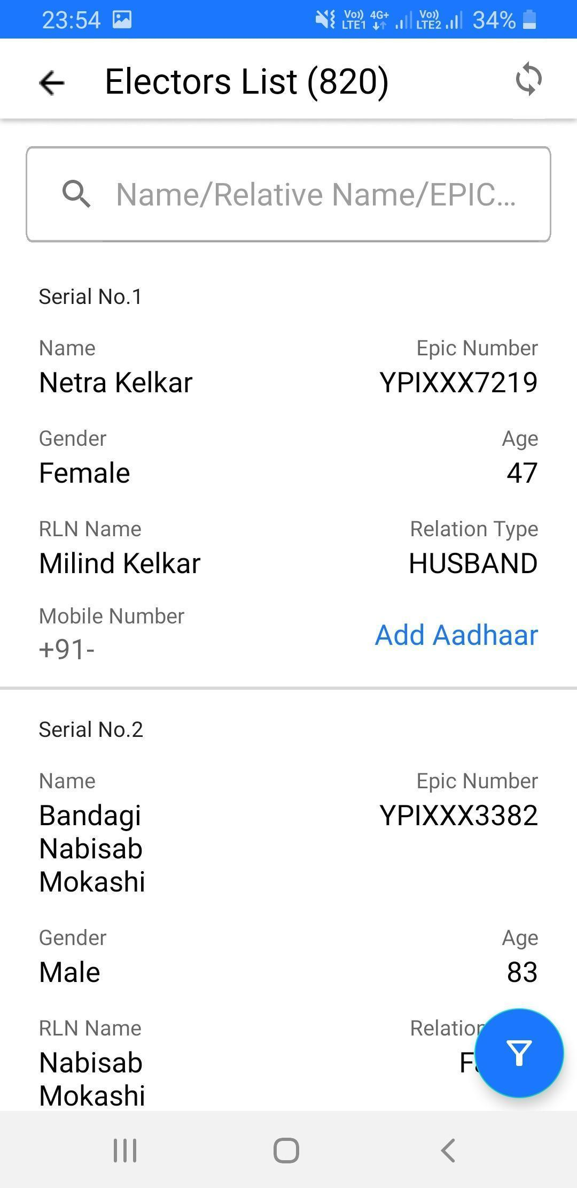
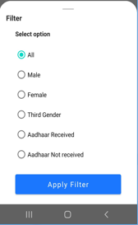

Total electors
By clicking on elector’s name, BLO can view elector’s address and photograph. If Aadhaar is not updated for elector, option to ‘Add Aadhaar’ will be shown. By clicking on ‘Add Aadhaar’ BLO will be re-directed to fill form 6B
By clicking on filter icon, BLO will be able to filter electors based on gender or Aadhaar
By clicking on ‘Total Electors’ hyperlink on Homepage, BLO will be re-directed to ‘Elector List’

Slide 9
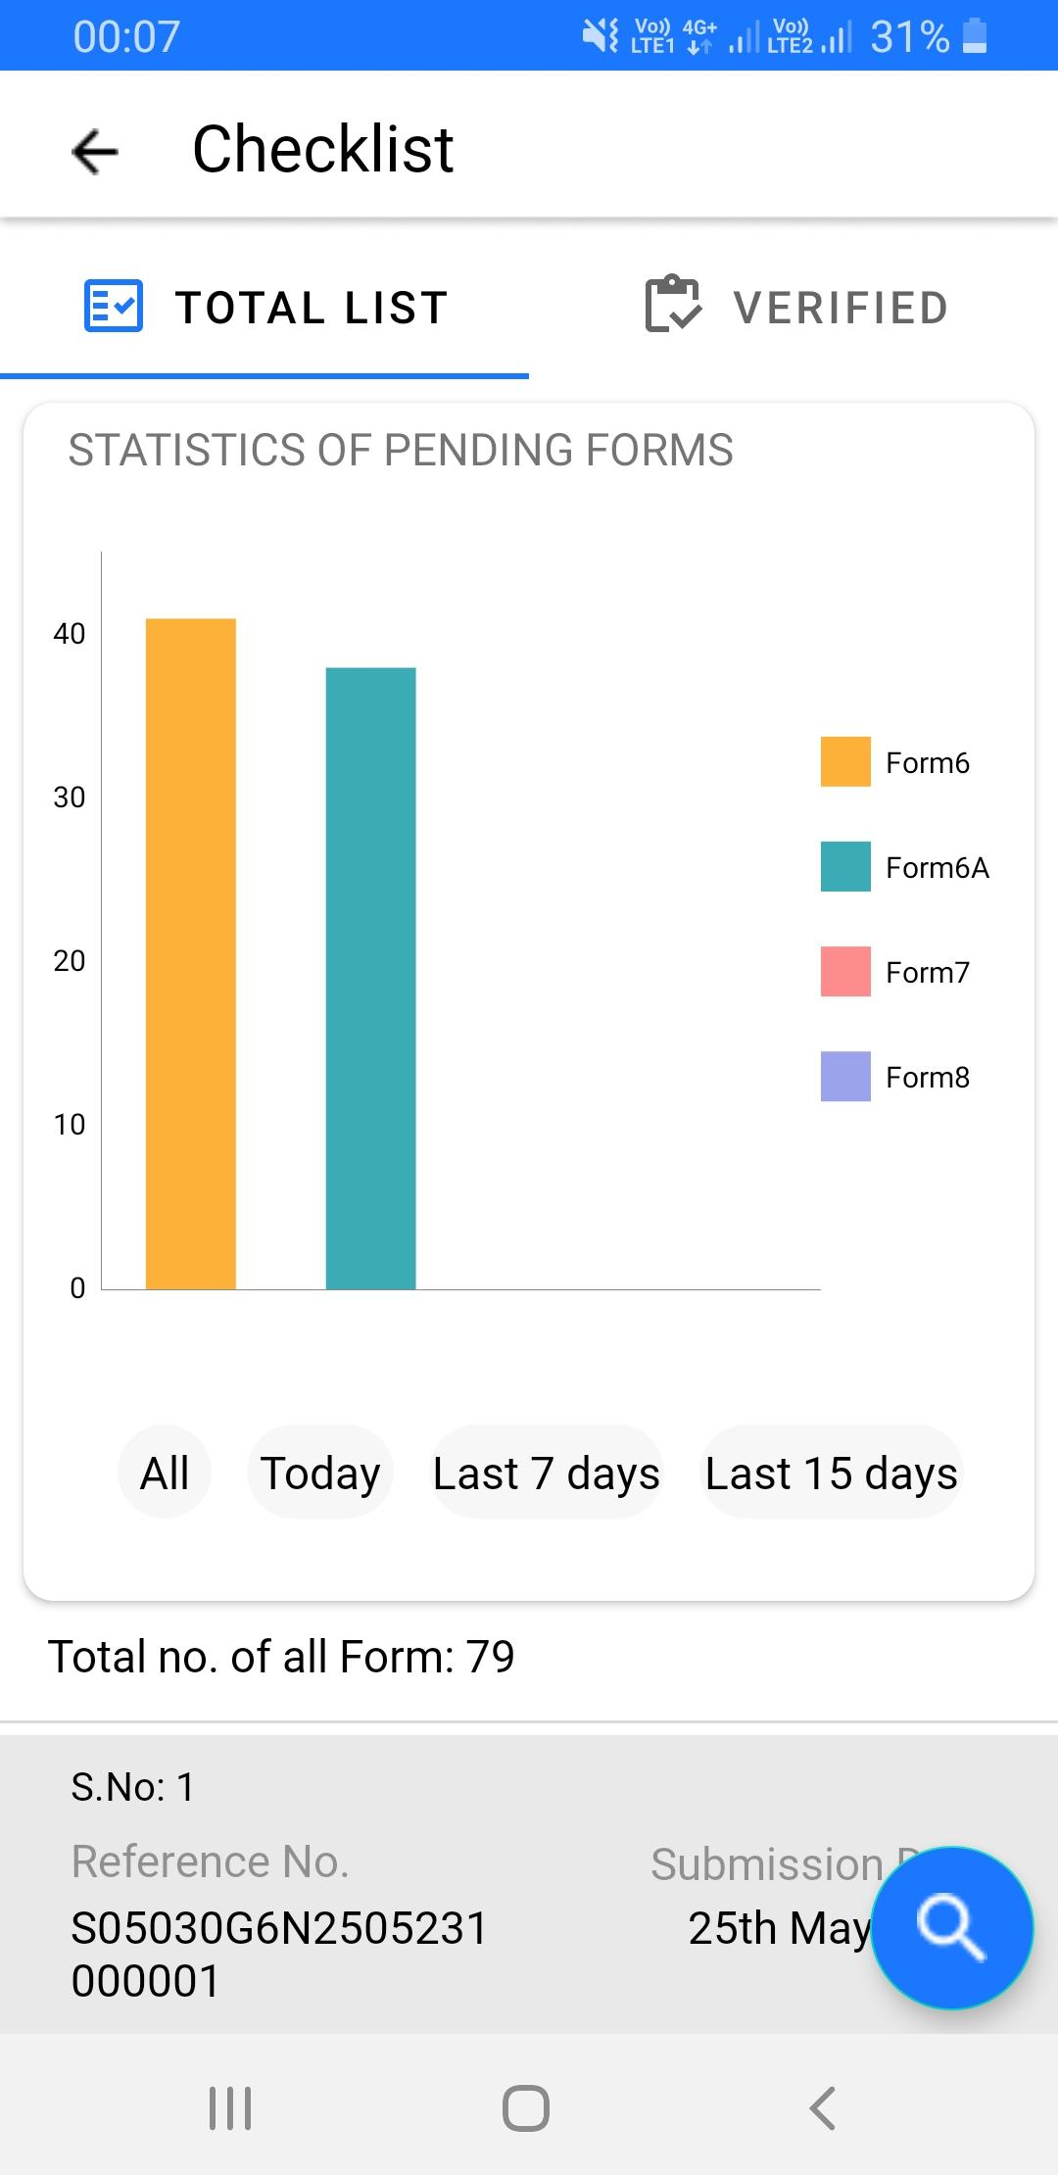
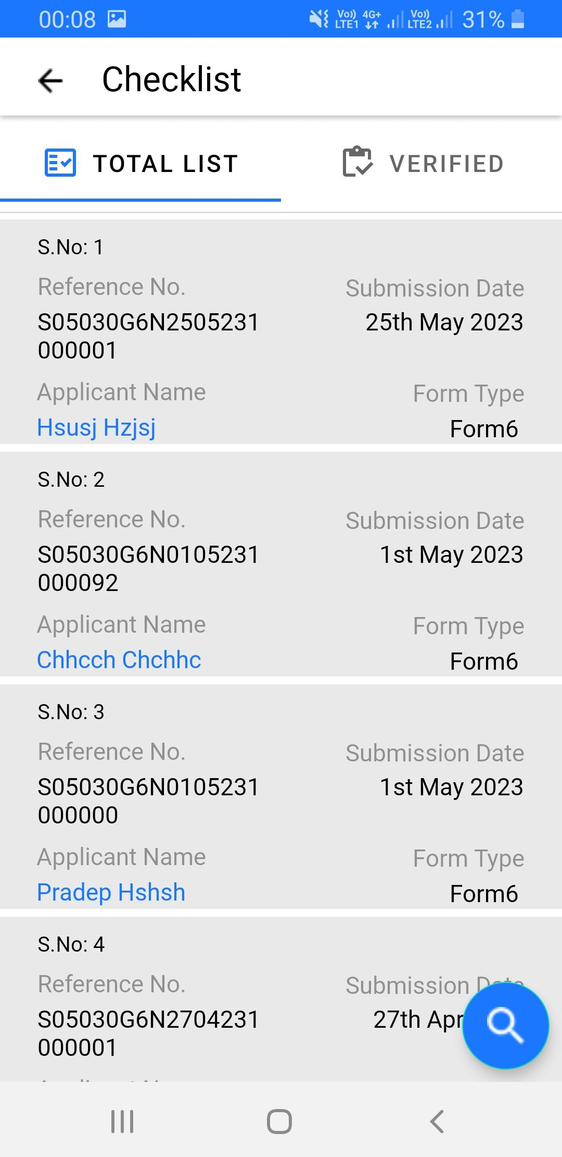
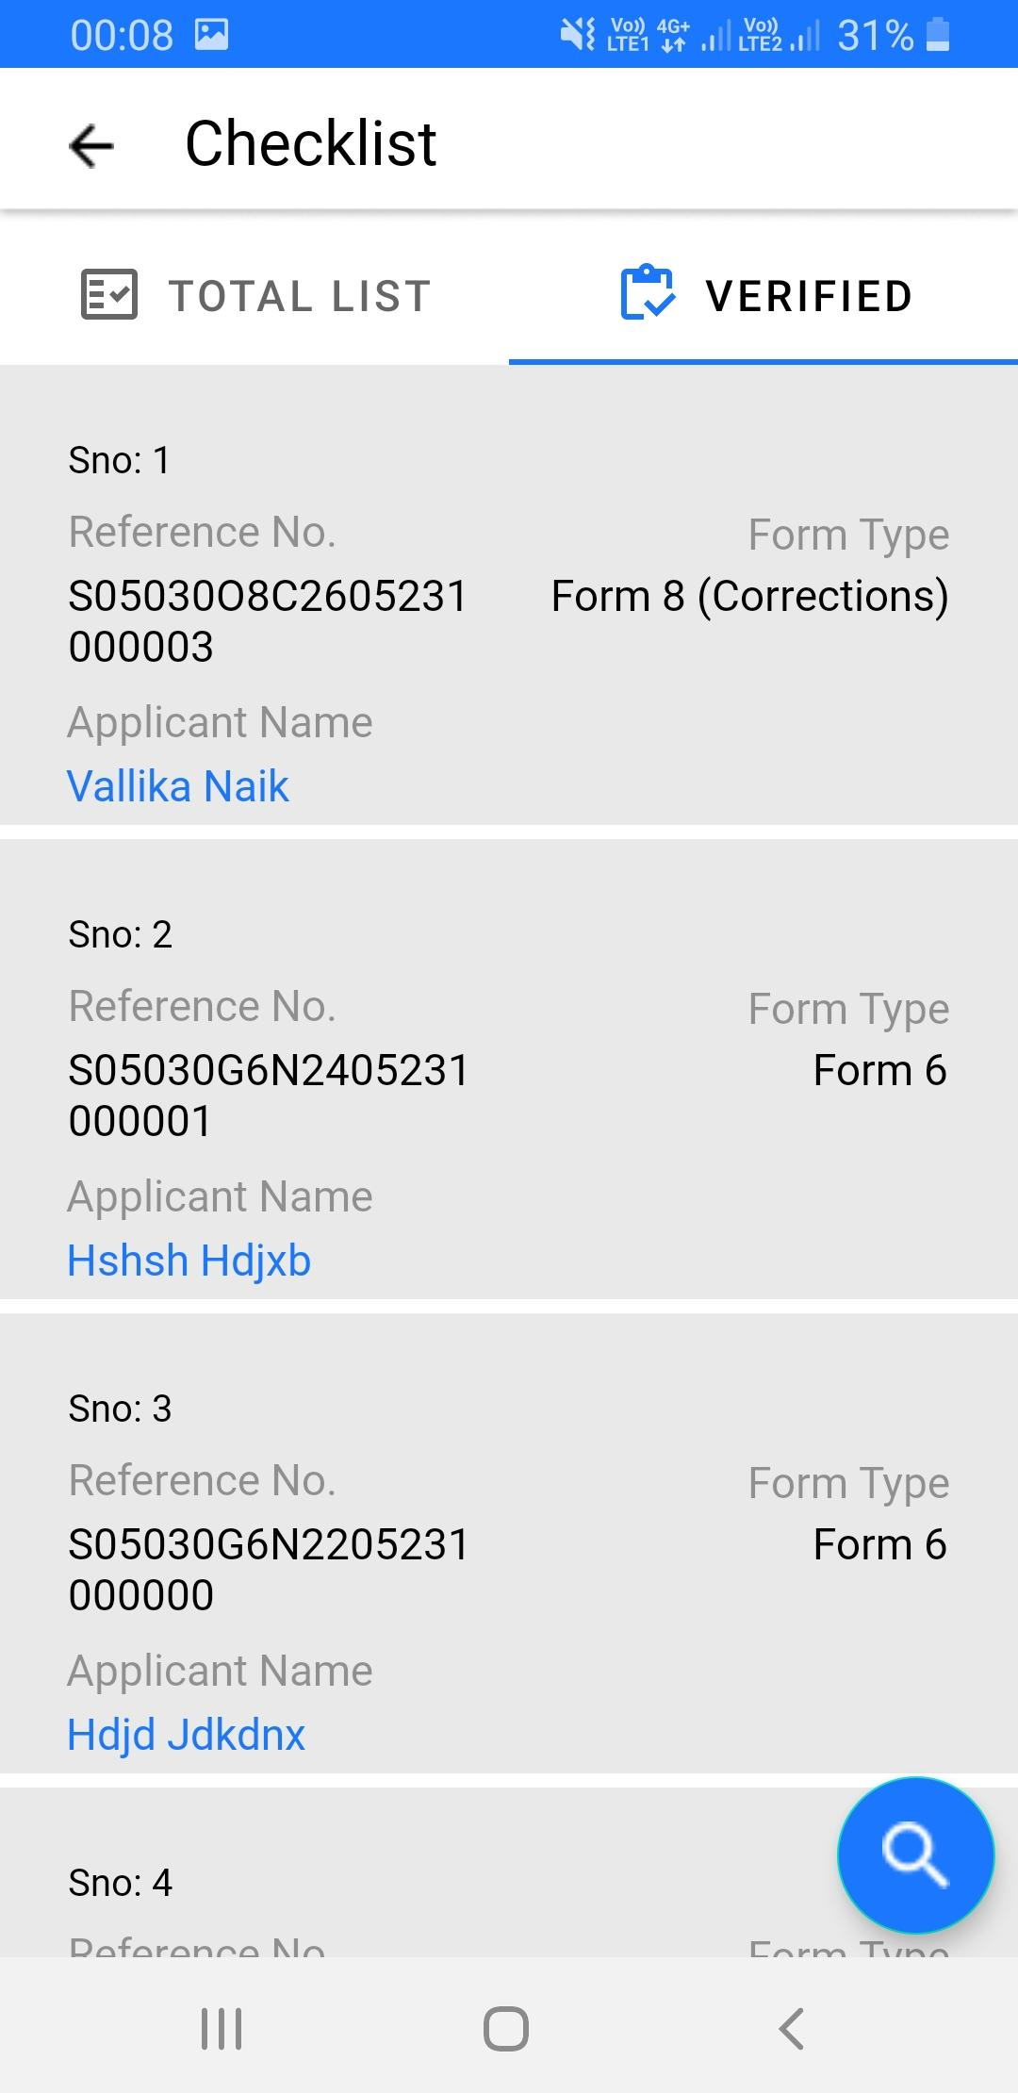

Checklist Submission
By clicking on checklist icon (as shown above), BLO will be directed to checklist tab, as shown on right.
BLO has to do field verification of forms assigned by AERO
Bar chart on checklist tab, helps BLO in having quick glance of pending forms with him
‘Total List’ tab :
BLO will see list of un-verified or partially filled checklist here
‘Verified’ tab :
Checklists completely verified by BLO will move from ‘Total List’ tab to ‘Verified’ tab

Slide 10
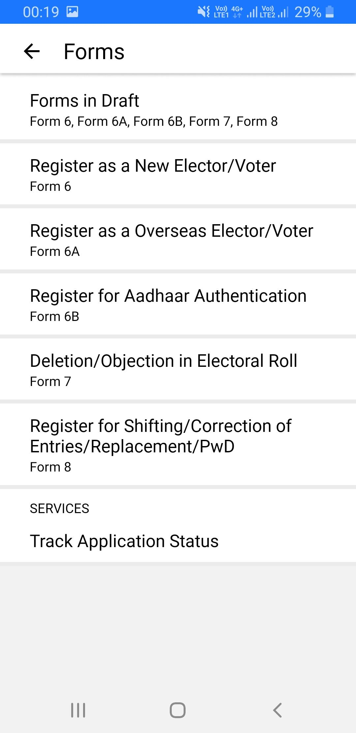
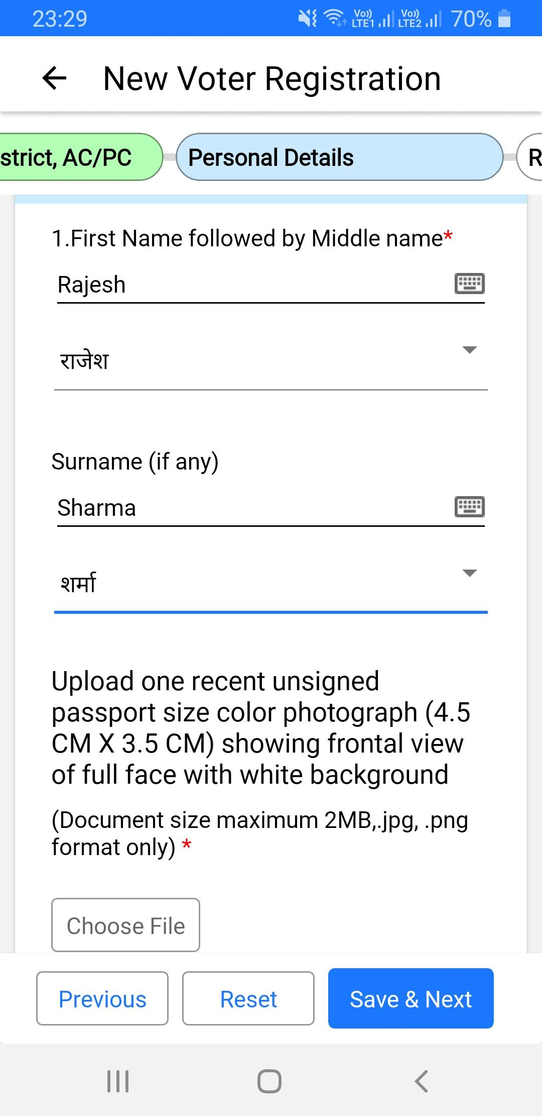
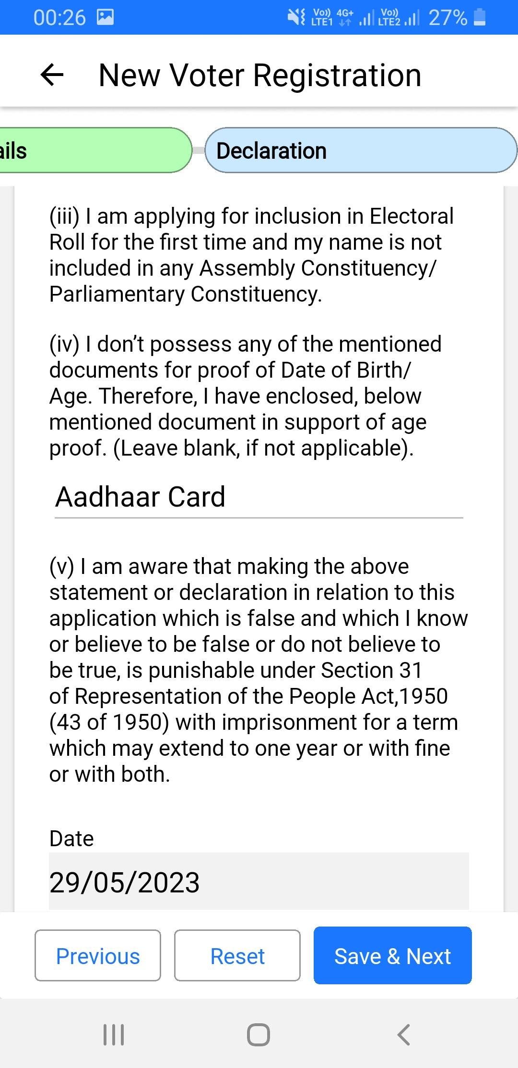

Submission of forms
By clicking on forms icon (shown above), BLO will be directed to forms menu:
Form 6/6A : New electors
Form 6B : Aadhaar information
Form 7 : Deletion/ Objection
Form 8 : Correction of entries/ change of address / PwD / replacement of EPIC
BLO can select relevant form from ‘Forms’ menu
BLO can move to next section in form only when required details are filled and documents are uploaded for current section
BLO has to fill declaration on behalf of elector. BLO has to preview before submitting the form

Slide 11

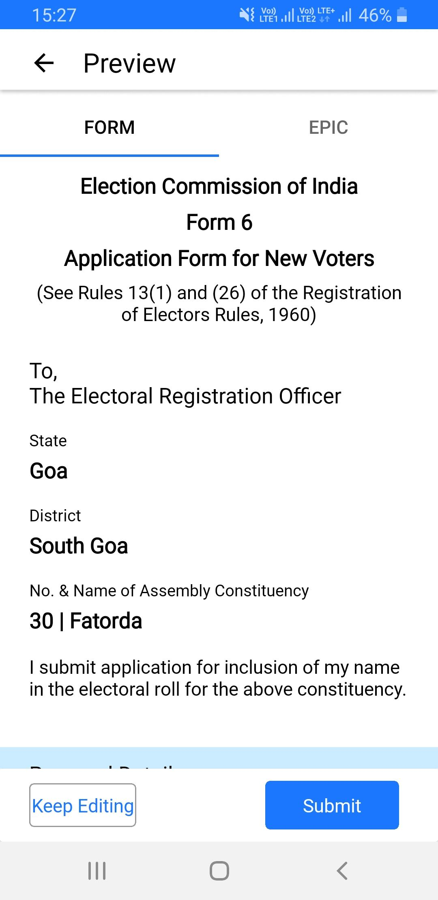
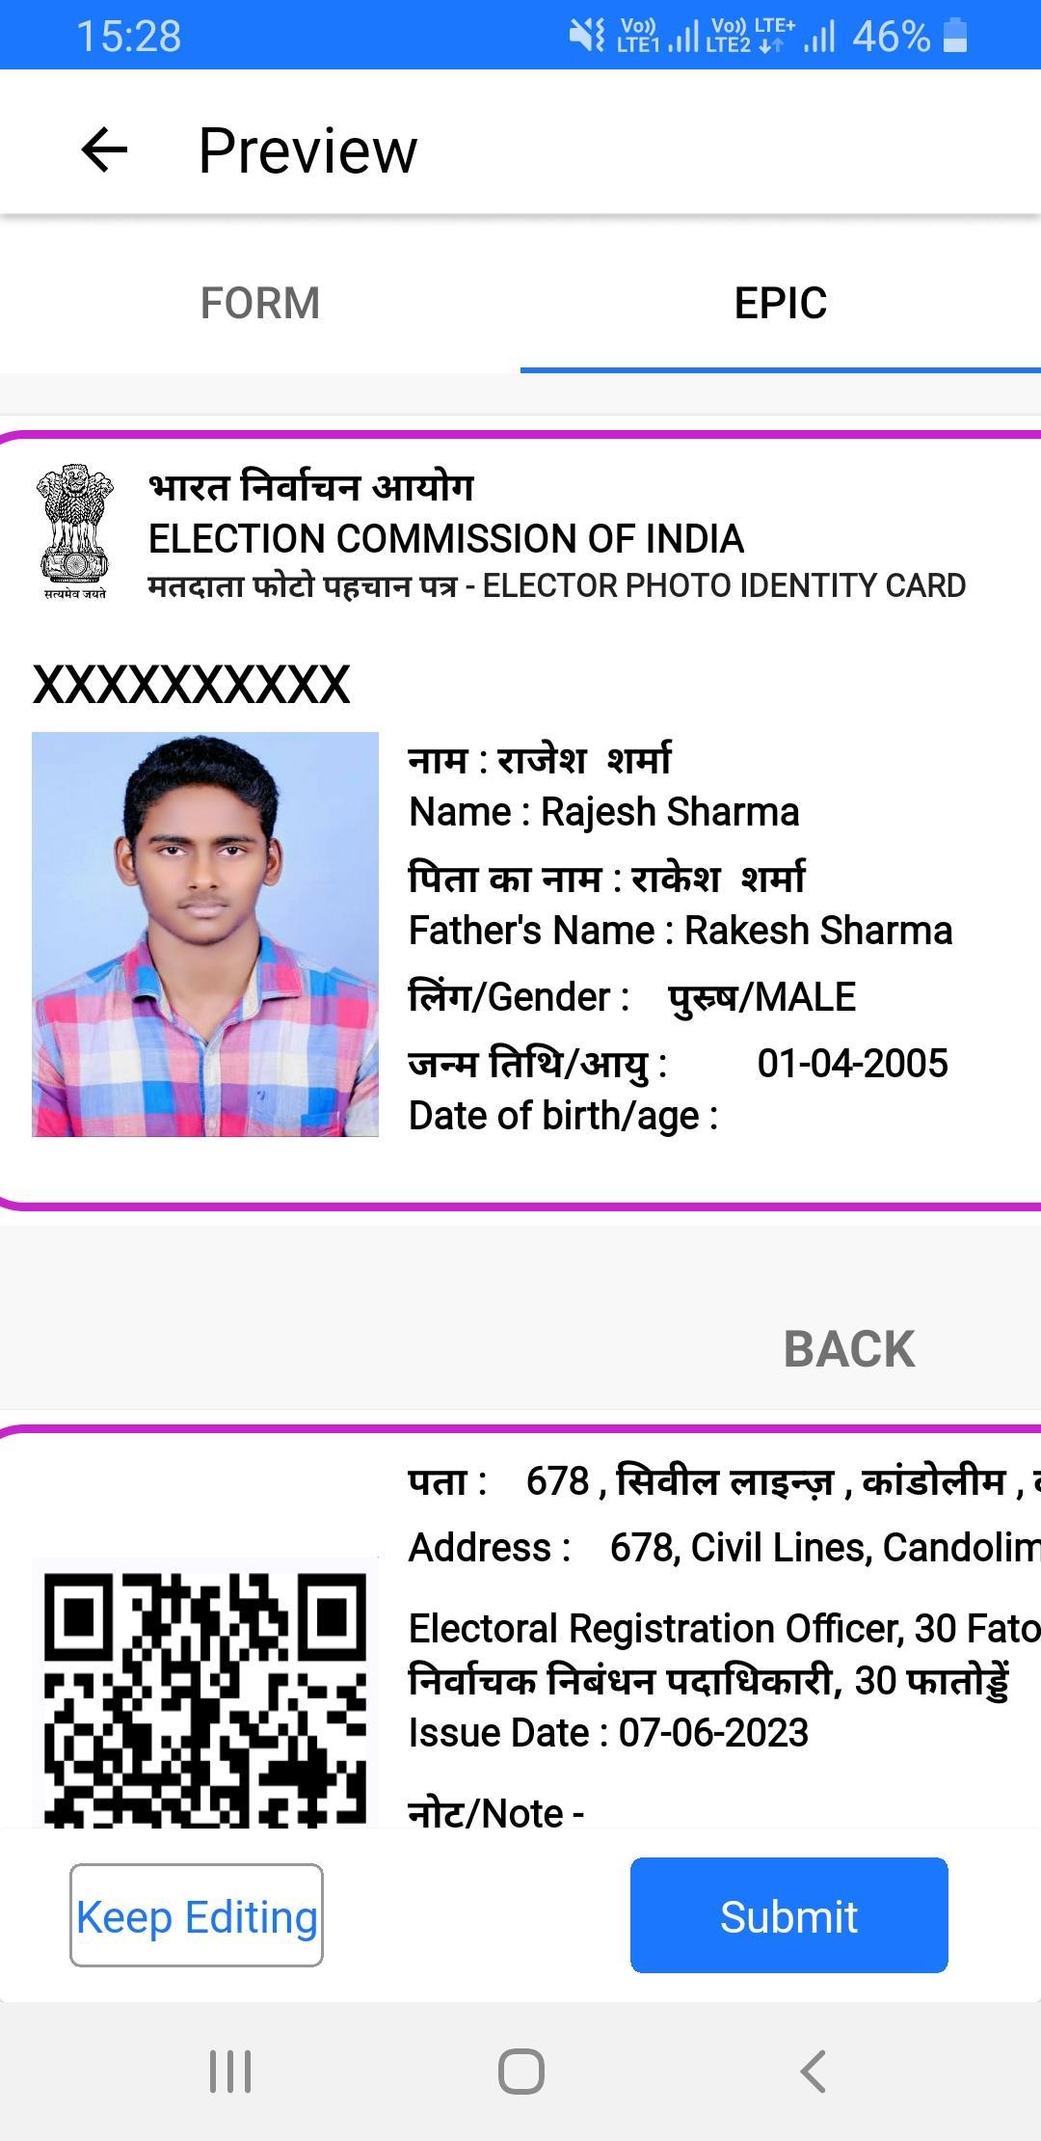
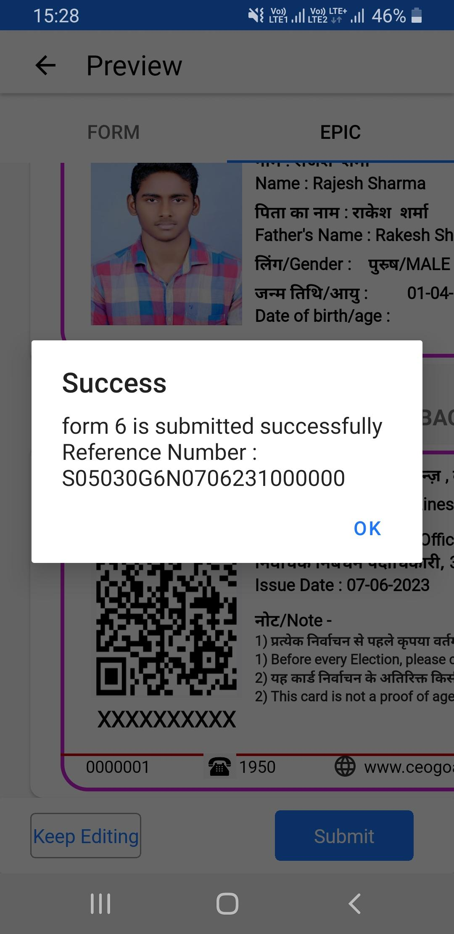
Submission of forms
BLO has to check all form details in form preview, if any discrepancy is found, BLO can go back to form for editing by clicking ‘Keep Editing’ button
In case of form 6, BLO as to preview EPIC as well
After verifying the form when BLO will click on Submit button, then form will be submitted and auto generated reference number will be shown on screen

Slide 12
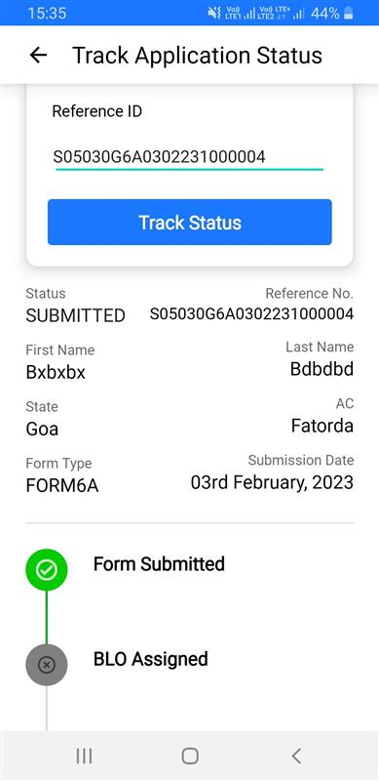

Tracking of forms
By clicking on ‘Track Application Status’ under forms section, BLO will be able to track forms
BLO has to mention application reference number and click on ‘Track Status’ icon to view current status of form

Slide 13

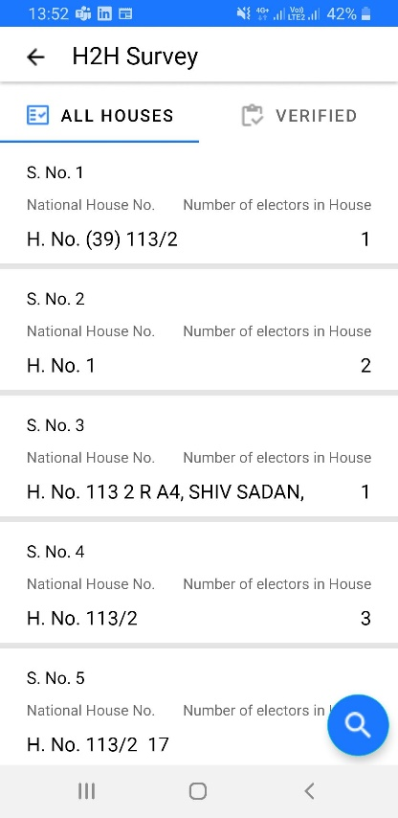
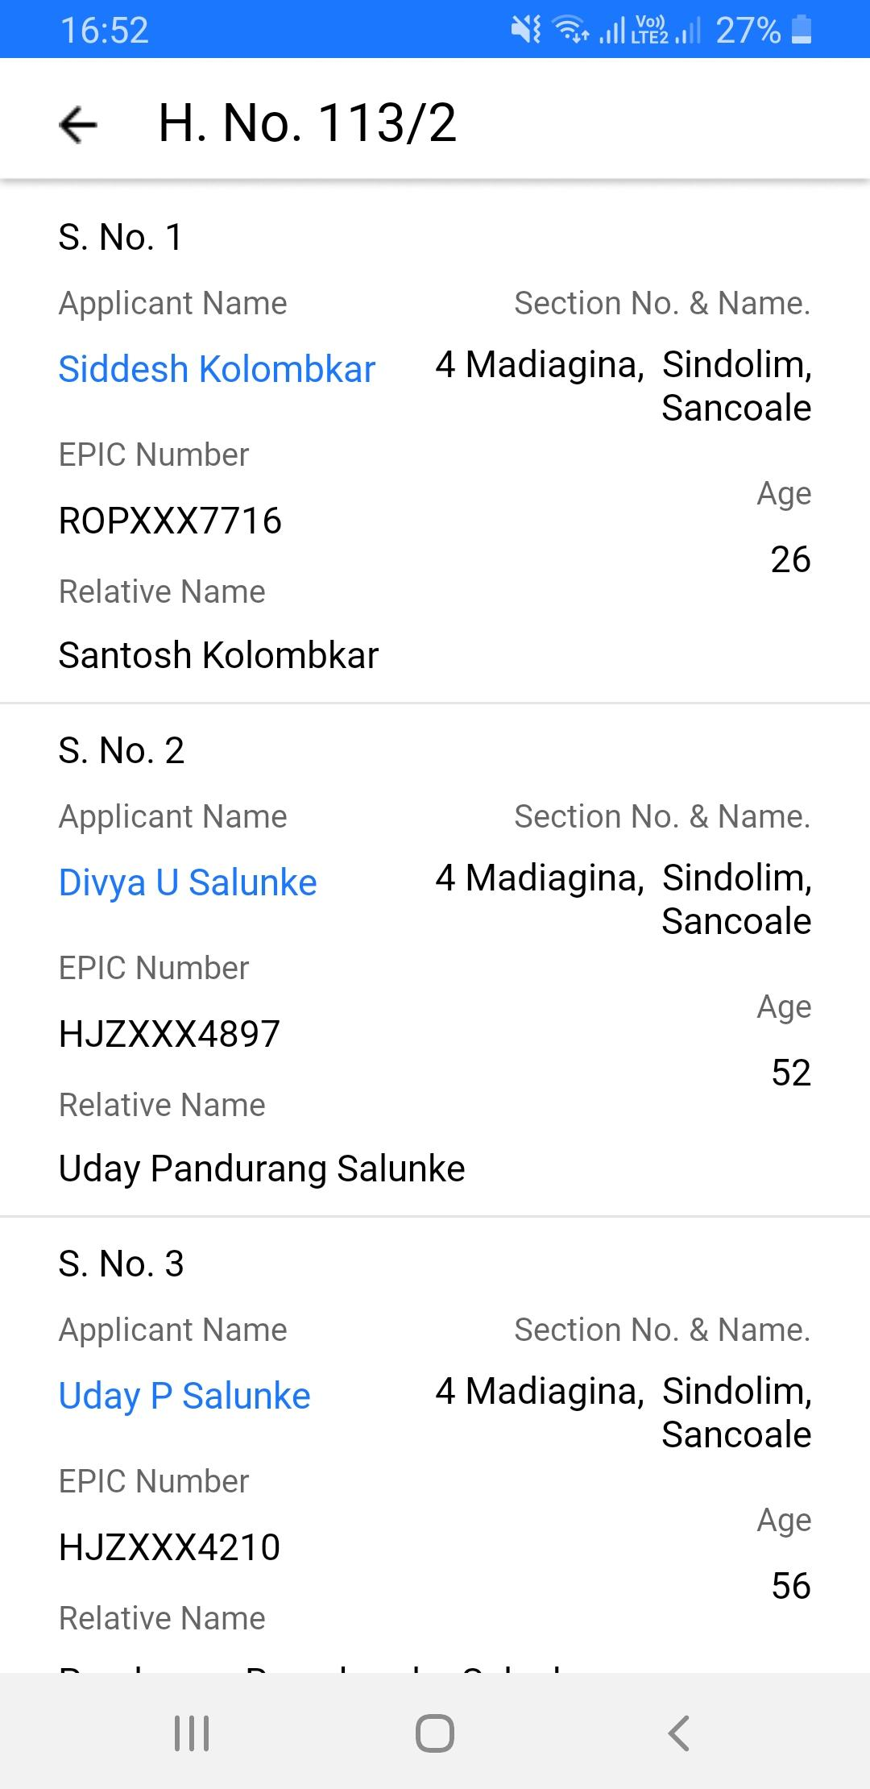
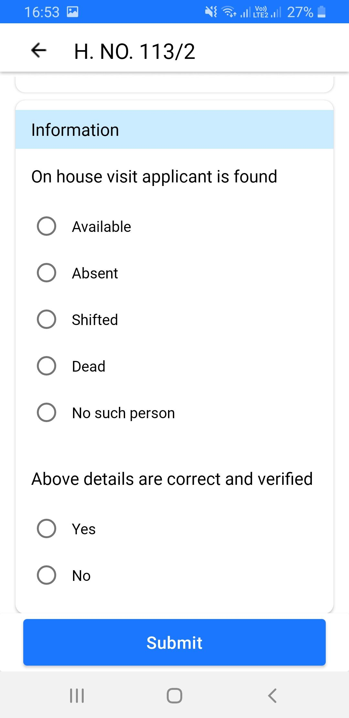
House to House survey
By clicking on ‘H2H Survey’ (House to House) icon (as shown above), BLO will be able to view Pending/Verified lists
BLO has to verify all the family members living in a house. Once, all the members are verified then only house is marked as verified
List of all the house members with basic details are displayed on selecting a house
BLO has to verify elector’s details, fill the required questions for marking elector as verified

Slide 14
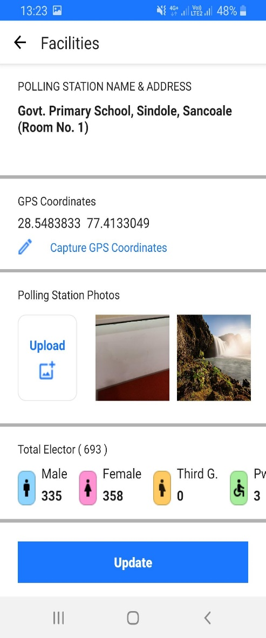
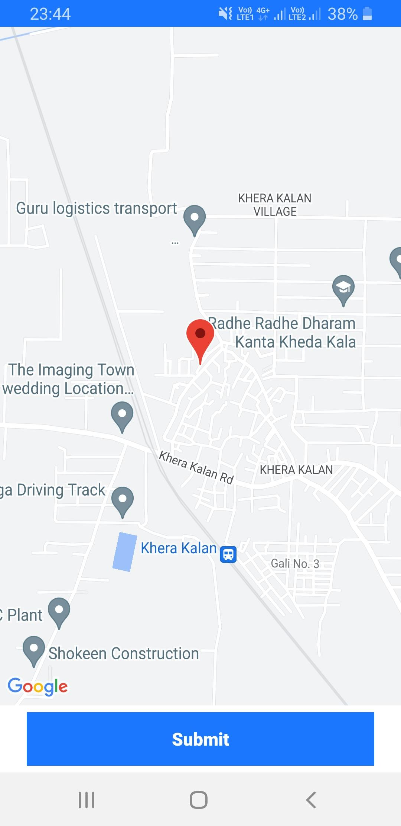
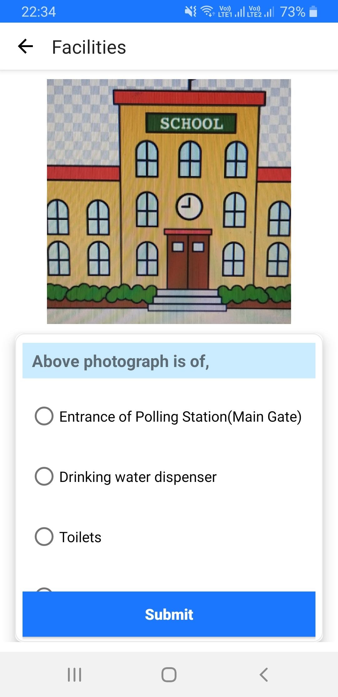
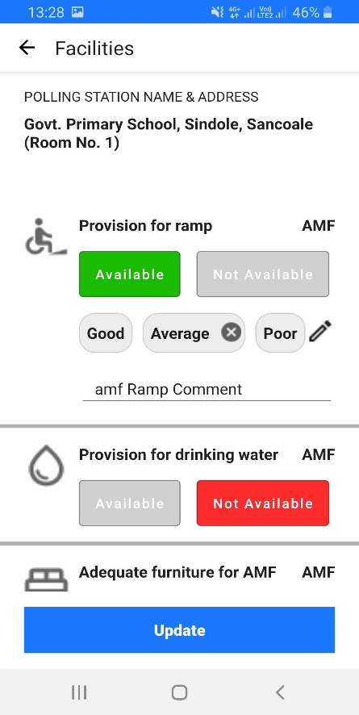

Updating Facilities in Polling station
By clicking on ‘Facilities’ icon ( as shown above), BLO will be able to view and update facilities in PS.
On clicking ‘Capture GPS Co-ordinates’, BLO will be able to select and set GPS location of PS on the map
BLO can update AMF / EMF as ‘Available’ or ‘Not Available’ and rate them as well
In ‘Polling Station Photos’, BLO can upload and mark photos of PS
Above window will appear by clicking on ‘Facilities’ icon.

Slide 15

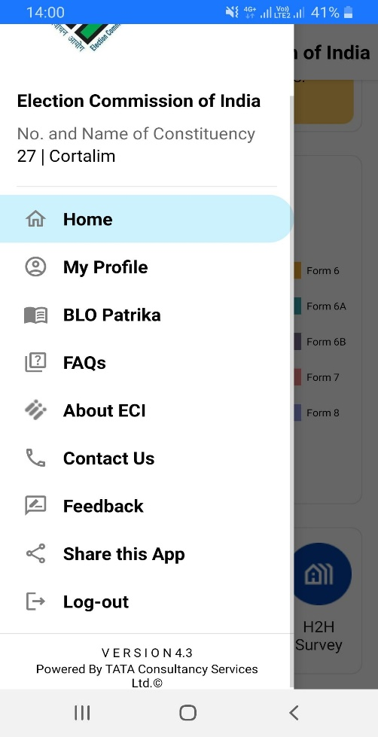

Menu Bar
BLO can return to dashboard on clicking this
BLO can edit his profile and changes will be sent to ERO for approval. But BLO cannot change parts assigned to him
ECI releases BLO E-Patrika to establish direct communication with Booth Level Officers. BLO can download and go through it.
This is for the feedback which BLO can share regarding the App working.
By clicking on Menu Bar icon (as highlighted in screenshot above), pop up for menu will open
BLO can log-out of BLO app by using this feature
BLO can view current version of App installed in mobile phone

Slide 16

Thankyou for being patient listener during course of presentation. Please use BLO App to know it better.
Disclaimer : This presentation is intended for educational and training purpose only.

Slide 17

Annexure
Minimum Device Compatibility Requirements:
Camera 5 megapixel
Available Storage: 5 GB
RAM: 2 GB
Internet should be connected.
Enabled GPS
Version: Above Lollypop
If mobile does not fulfil any of the above condition, then BLO will not be stopped from using BLO app. But whenever that missing functionality is required, pop up will ask for access to use that feature of mobile phone

